Slide 1
Midpoint Presentation
By: Ayan, Deniz and Sanjana

Slide 2
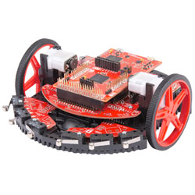
Overview
Whole research revolves around the TI -RSLK, a product that allows students to explore robotics in real life applications
First part of the research is to build the TI-RSLK following the manual that it came with
Second part of the research is to implement an ECE 110 circuit to the robot, so that it can drive straight and the speed is controlled
Last part of the research is to implement our own circuit using the vast amount of sensors given to us (ie. photosensor, sound sensors, microphone).

Slide 3
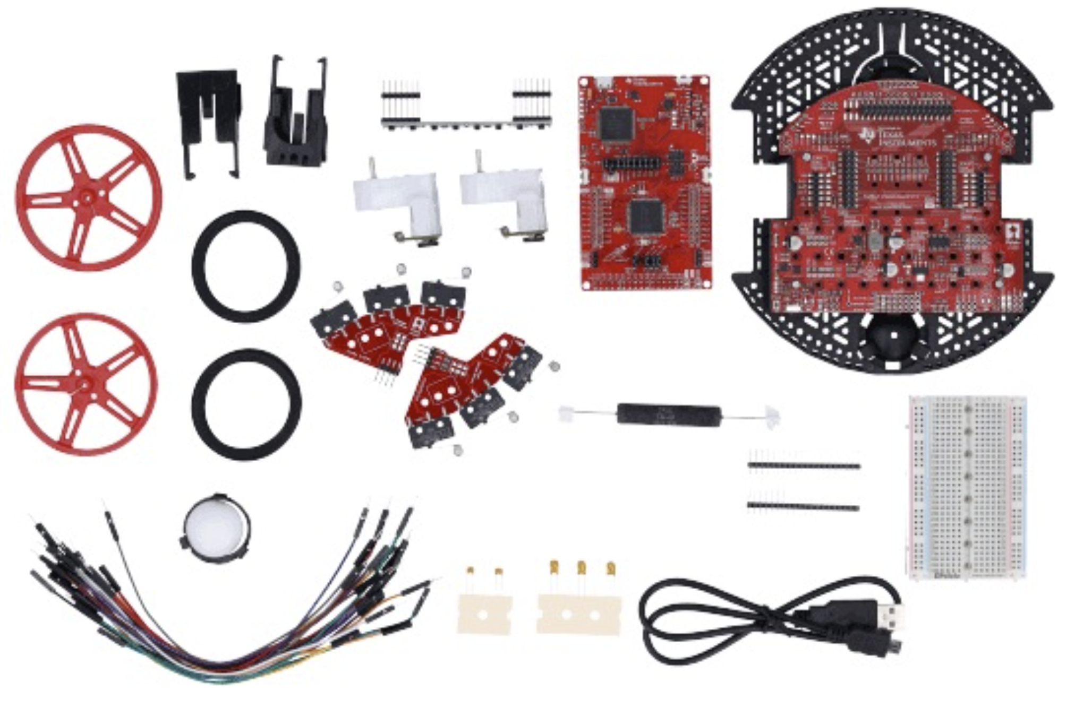
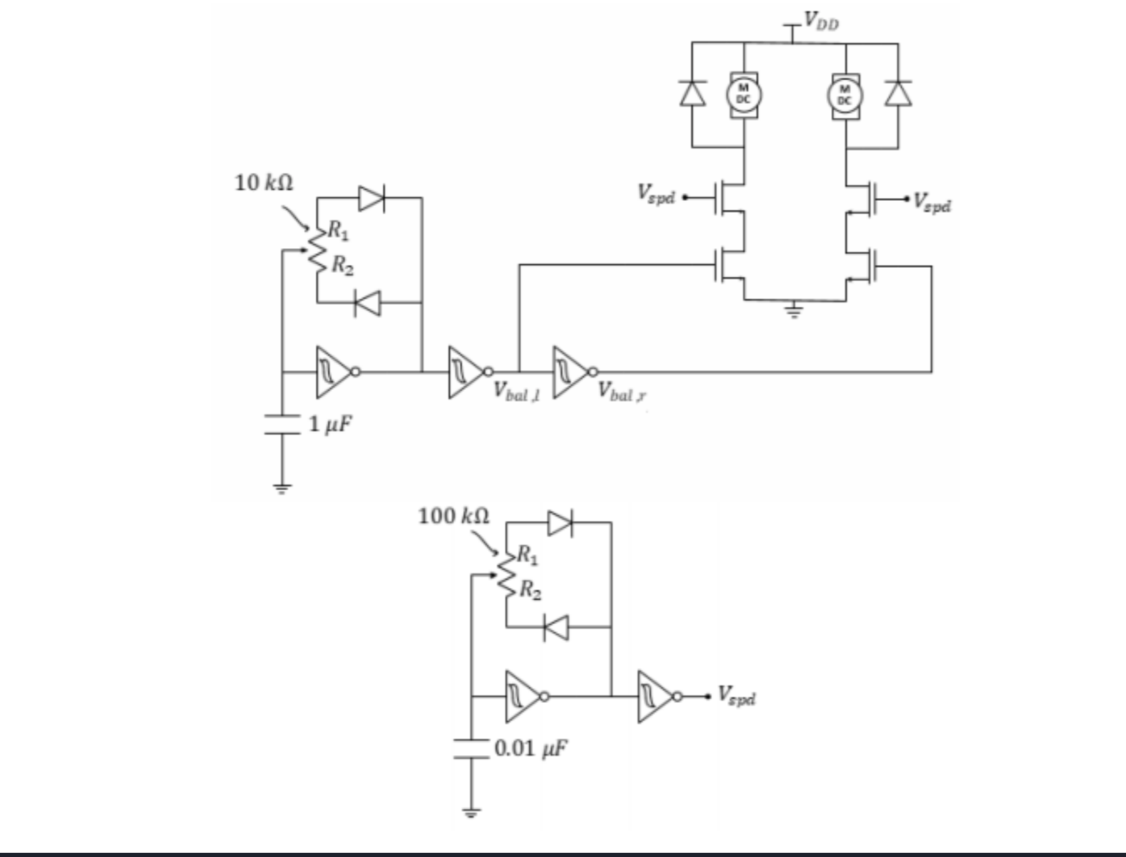
Techniques
To build the TI-RSLK, we followed the manual to attach all of the parts that were given to us
Came with chassis board, tires and wheels, left and right bumper switches, chassis ball caster kit, motor, and 8 channel sensor array
To integrate the ECE 110 circuit, we attach a breadboard on top of the TI-RSLK
Using a combination of a capacitor, resistors, diodes, a potentiometer, inverters, and mosfets, we build a circuit that will control the speed of the TI-RSLK and makes it drive in a straight line direction.

Slide 4
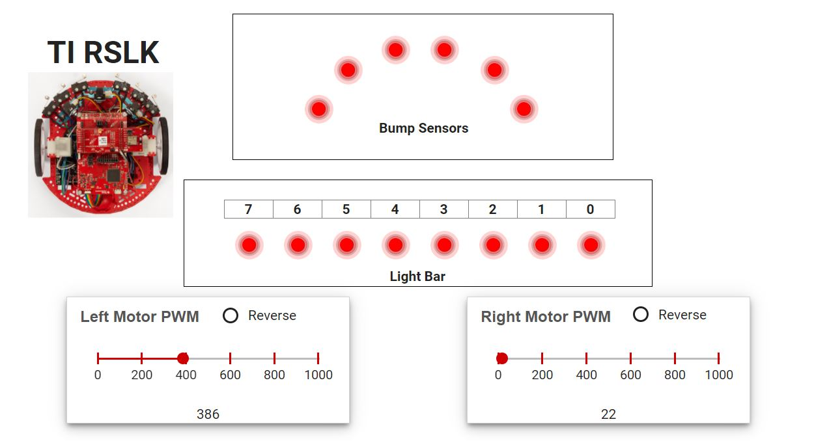
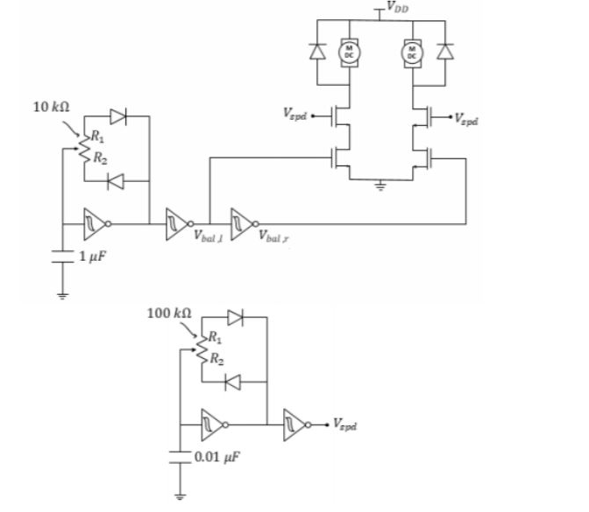
How far have we come?
Followed instruction manuals and online tutorial videos, we assembled the TI-RSLK robotics kit.
We attached the tire and wheels, the left and right gear motor, the line sensor array and bumper switches.
Tested out the robot car we built using the RSLK debugger to ensure the wheels, LEDs, motors, bump sensors and light bar on the sensor array work as required
Designing the circuit schematic to replicate the ECE 110 circuit that allows us to recreate the robotic car whose speed and direction can be controlled.

Slide 5
Goals to achieve
Having an autonomous robot car, with wheels driven by the motor controller circuit linked to limit-switches on the front of the car. Seamlessly making turns against an obstacle.
Minimize the circuit design to reduce variety and quantity of materials, making the circuit easier to work with and shrink BOM.
Possibly incorporating further sensors such as an ultrasonic sensor to trigger turning without contact with an obstacle, or the light sensors on the bottom of the car to achieve line following.

Slide 6


